Slide 1

Group : Mikes
Team Members
Neelima Kommareddy
Sindhu Anugula
Kalwa Sailaxmi

Slide 2

Healthcare Chatbot: Utilizing Artificial Intelligence for Medical Diagnosis

Slide 3

Statement
The purpose of this project is to develop an AI-powered healthcare chatbot that can help with diagnosis. In order to give patients a convenient way to submit their symptoms and obtain a preliminary diagnosis, the chatbot will be built. If necessary, the chatbot will also offer suggestions for additional medical assessment. Enhancing the precision and effectiveness of medical diagnosis is the aim of this initiative, particularly when patients do not have quick access to a healthcare provider

Slide 4

Approach
Data Collection : - Collecting a large dataset of medical records and symptoms to train our AI model.
Model Development : - Developing a deep learning model that uses natural language processing to analyze patient symptoms and provide accurate diagnoses.
Integration with Chatbot :-Integrate our AI model with a chatbot interface to provide users with an easy-to-use and accessible platform for medical diagnosis.

Slide 5
Deliverables
Functional Healthcare Chatbot :- Our team will develop a functional healthcare chatbot that utilizes AI to assist in medical diagnosis.
Integration with Medical Databases :- The chatbot will be integrated with various medical databases to provide accurate and up-to-date information.
User Testing Results :- We will provide user testing results to evaluate the effectiveness and efficiency of our chatbot.

Slide 6

Evaluation Methodology
Accuracy Metrics :- The accuracy of the chatbot's diagnosis will be evaluated using metrics such as precision, recall, and F1 score.
User Feedback :- User feedback will be collected through surveys and interviews to evaluate the chatbot's usability, effectiveness, and overall satisfaction.
Data Analysis :- We will analyze the data collected by the chatbot to identify trends and patterns in medical diagnoses.

Slide 7

Advantages
24/7 Accessibility
Instant Response
Cost-Efficiency
Personalized Assistance
Reduced Anxiety

Slide 8

Limitations
Lack of Empathy
Limited Understanding of Nuances
Security and Privacy Concerns
Dependency on Data Quality
Inability to Handle Emergency Situations
User Trust and Adoption

Slide 9
Overview of the Model
Loading
Data Preprocessing
Data splitting
Decision tree making
Binary search in tree
Print
Loading csv file
Define and train decision classifier
Search for disease on user input
Input features and labels
Split into test and train data
Output mapped disease

Slide 10
Decision Tree
Decision Tree Generation
Training data
Select Best Attributes using ASM such as Information gain or Gini Index or Gain ratio
Breaks the Dataset into Smaller Subsets
Data
Recursively repeat the process for each child
Testing data
Model Evaluation
Performance Evaluation Measures
1.Accuracy
2.Precision
3.Recall

Slide 11
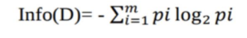
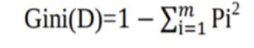
Factors to Consider
Information gain :- The decrease in entropy is known as information gain. Based on speciﬁed attribute values, information gain computes the difference between entropy before split and average entropy after split of the dataset. (In a system, entropy is the randomness)
Gini Index :- The Gini Index takes each attribute into account as a binary split. A weighted total of each partition's impurity can be calculated.

Slide 12
Dataset
Training dataset : 113 features , 4920 samples
Testing dataset: 113 features, 41 samples
As a label, the word "prognosis" is utilized.
Label Encoder is a program that converts labels into numerical values.
Before Label Encoder | After Label Encoder
Migraine | 1
Heart Attack | 2
Typhoid | 3
Acne | 4

Slide 13

Cross validation , Testing and Training
clf1 = DecisionTreeClassifier()
clf2 = clf1.fit(x_train,y_train)
print(clf2.score(xtest,ytest))
Cross-validation:
scr = cross_val_score(clf2, x_test, y_test, cv=3)
Print(scr.mean()

Slide 14
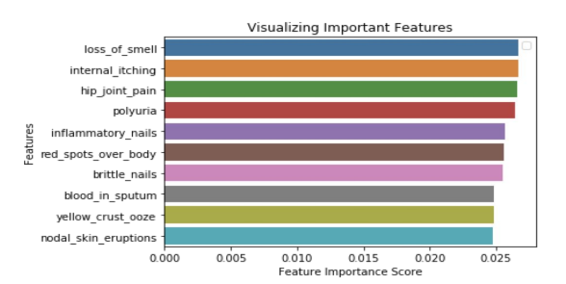
Results
Accuracy of training: 0.97
Accuracy of testing:0.94
Important Features

Slide 15
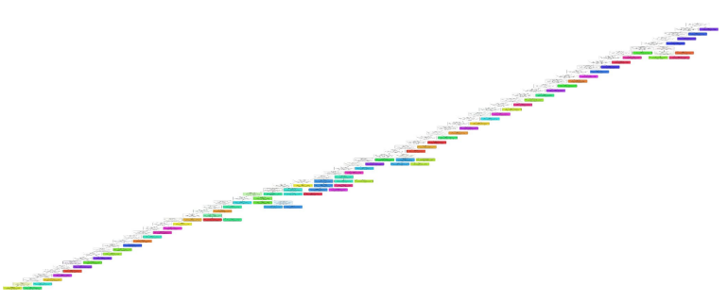
Decision Tree

Slide 16
Important Function(code)
Binary search in tree(): A Decision_tree_bot() subfunction that does binary search based on user responses to the bot's questions.
Print disease to user(): This function converts the decision tree output into one of the user's diseases.
Decision tree bot(): The Decision Tree Primary Logic Main() : When the program is run, the main() function is executed

Slide 17
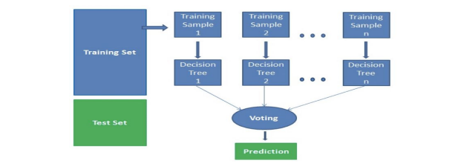
Future Enhancements
Random Forest can be employed to address overfitting issues associated with noisy data in Decision Trees. However, it's important to note that ensemble techniques like Random Forest are more effective when applied to extensive datasets.

Slide 18

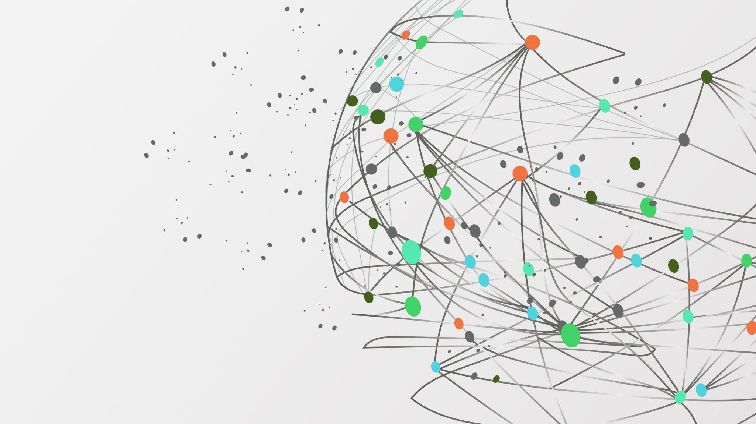



Thank You

